Slide 1
Seamless Manipulation of eda ,visualization and SQL
BY Mohan Prabhu

Slide 2
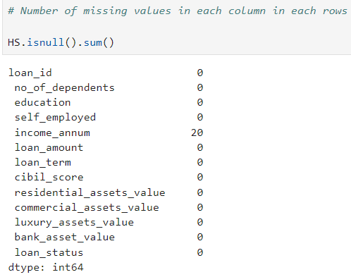
EDA on Loan Dataset
Key Factors
The key variables include
• income_annum
• loan_amount
• loan_term
• cibil_score
• residential_assets_value
• commercial_assets_value
• no_of_dependents
• education
• self_employed

Slide 3
The process of exploring, visualizing, and querying data often involves cumbersome tool switching and manual data manipulation. This can lead to bottlenecks, inefficiencies, and wasted time.
Connecting SQL and Python for Exploratory Data Analysis (EDA) combines the strengths of both technologies, enabling more efficient and comprehensive data analysis.
Data Retrieval and Management:
SQL for Data Retrieval: SQL is designed to efficiently retrieve, filter, aggregate, and manipulate large datasets directly from relational databases. It allows you to perform complex queries to extract only the relevant data needed for analysis.
Python for Data Processing: Once the data is retrieved, Python, with its extensive libraries like Pandas, NumPy, and SciPy, excels in data manipulation, transformation, and cleaning.

Slide 4
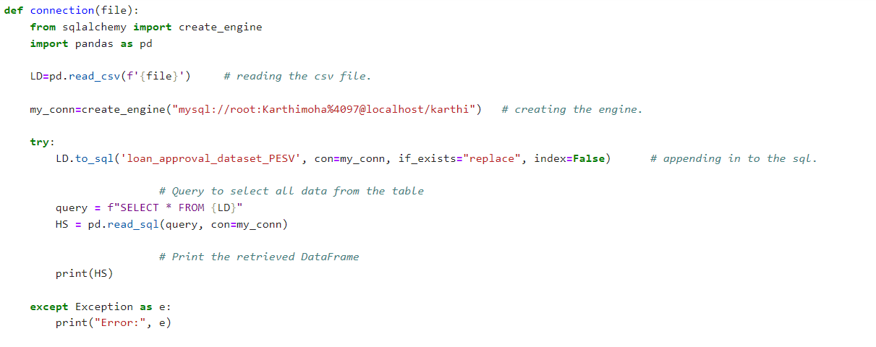
Separation of Concerns:
Database as the Source of Truth: Databases are optimized for storing and managing large volumes of data. By using SQL, you can ensure you're working with up-to-date data and leverage the database's power to handle data-intensive operations.
Python for Analysis and Visualization: Python provides powerful libraries such as Matplotlib, Seaborn, and Plotly for visualization, as well as SciPy and Statsmodels for statistical analysis. This allows for more sophisticated EDA techniques and clearer data presentation.

Slide 5
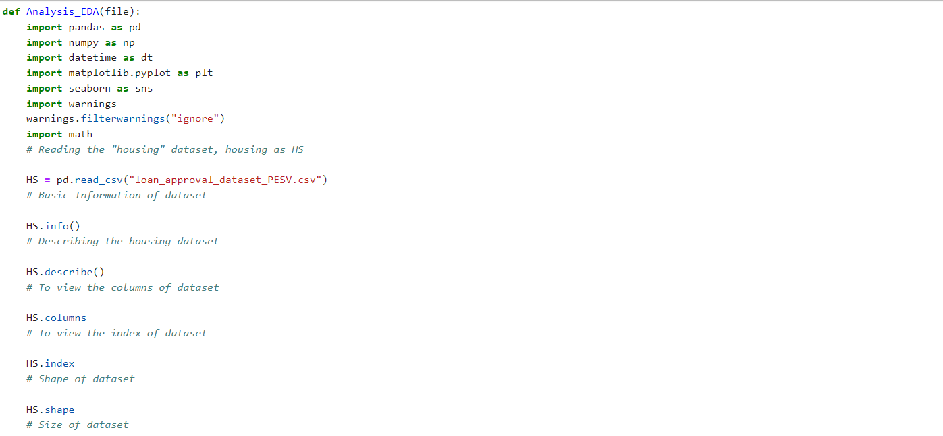
Scalability and Performance:
Efficient Data Handling: SQL can perform operations like joins, aggregations, and subqueries efficiently on the server side, reducing the amount of data transferred to Python. This can significantly speed up the EDA process, especially with large datasets.
Python for Complex Calculations: Python can handle more complex calculations and custom functions that might be cumbersome or impossible to implement in SQL.

Slide 6
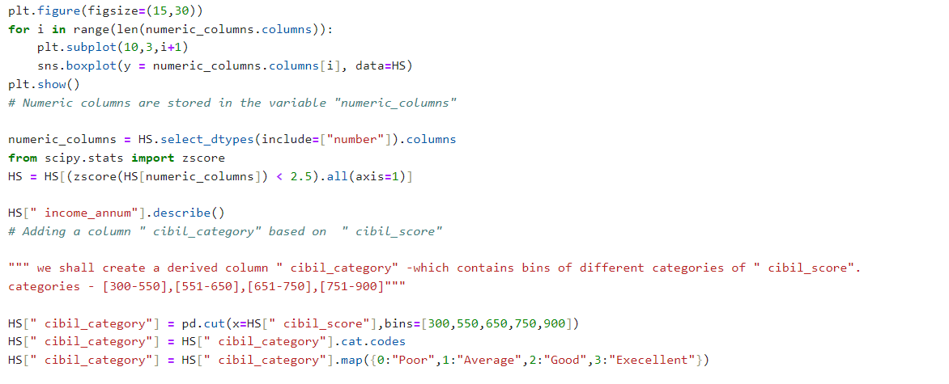
Reproducibility and Automation:
Automated Workflows: By integrating SQL queries in Python scripts, you can create automated workflows that consistently fetch and process data, making the EDA process reproducible and less error-prone.
Reusability: Python scripts can be reused and modified for different datasets or updated data, enhancing productivity.

Slide 7
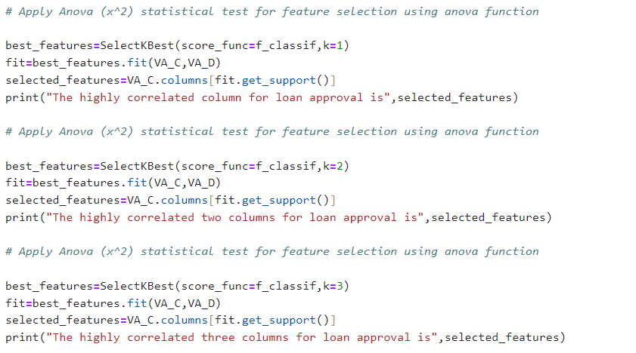
Flexibility and Customization:
Customized Analysis: Python allows for more flexible and customized analysis, including machine learning and advanced statistical methods, which can be integrated seamlessly with data fetched using SQL.
Interactive Analysis: Using tools like Jupyter notebooks, you can create interactive analysis environments that allow for iterative exploration of data.

Slide 8
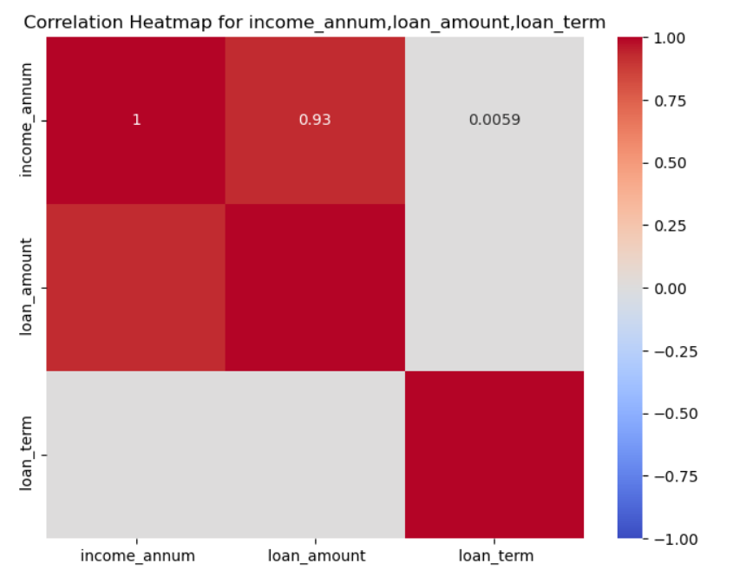
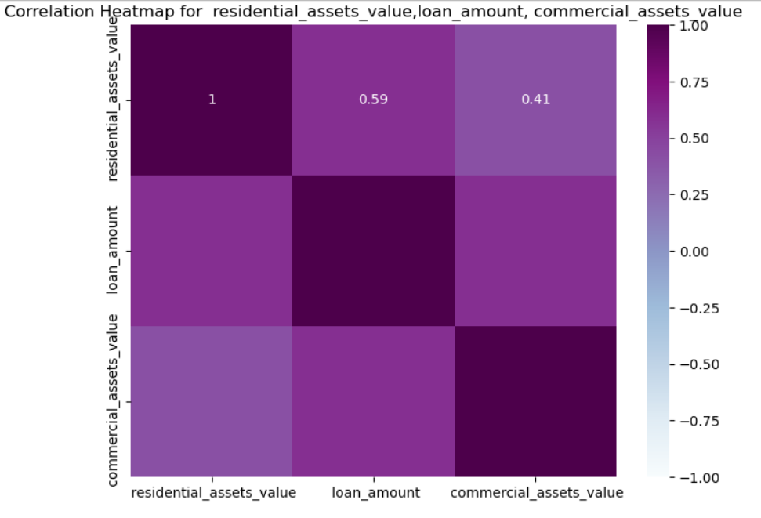
Visualization in Python is essential for making data-driven decisions, identifying key insights, and effectively communicating findings. It enhances the analytical capabilities of data scientists and analysts, enabling them to explore and understand data more deeply.

Slide 9
Thank You

